Slide 1

INSTITUTE UIE
DEPARTMENT ACADEMIC UNIT-1
Bachelor of Engineering (Computer Science & Engineering)
Subject Name Introduction Electrical & Electronics Engineering
Subject Code 23ECH-101
Prepared By
Dr. Shikha
Unit-2 Chapter-2
Combinational and Sequential Circuits
Lecture No. 2.1.6
Magnitude Comparator
DISCOVER . LEARN . EMPOWER

Slide 2

Lecture Objectives
S. No. | Objectives
1 | To make student aware about the derivation of logic for the design of magnitude Comparator.
2 | To aware about implementation of Magnitude Comaparator circuit.
3 | To learn about design of different design of Magnitude Comaparator.

Slide 3
Course Objectives
S. No. | Objectives
1 | Understand Electrical & Electronics Engineering Fundamentals
2 | To prepare students to perform the analysis and design of various Electrical & digital electronic circuits.

Slide 4
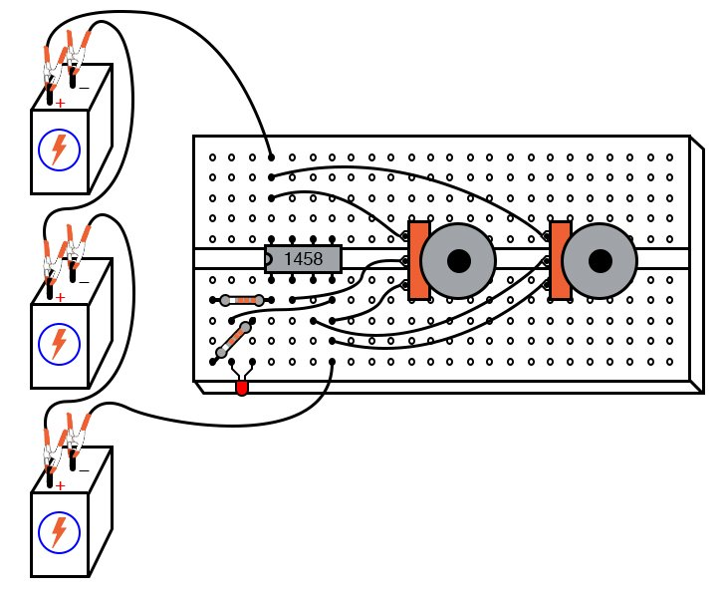
Magnitude Comparator
Course Outcome
CO Number | Title | Level
CO1 | To identify the different types of electrical elements and the basic op-amp circuit elements and to illustrate the various types of motors, transducers. | Remember
CO2 | To understand basic principles of transformers, transducers, op-amps, DC and AC motors and to compare the different methods for analysing electrical and magnetic circuits. | Understand
CO3 | To derive the relationships between parameters in electric and magnetic circuits and motors and to determine specifications of op-amps. | Analyze
CO4 | To solve the basic problems related to electric circuits, magnetic circuits and motors and to assess the characteristics of different configurations of op-amps. | Evaluate
CO5 | To design the different applications of transducers, motors as well as the op-amps like adders, subtractor and comparators. | Create
Figure 1.1 Practical application of comparators [1]

Slide 5
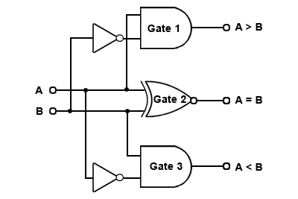
Magnitude Comparator
Definition
Classification of comparators
Figure 1 Magnitude Comparator

Slide 6
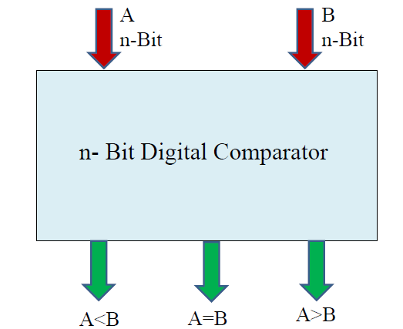
Magnitude Comparator
It is a combinational logic circuit.
Magnitude Comparator is used to compare the value of two binary digits.
There are two types of digital comparator (i) Identity Comparator (ii) Magnitude Comparator.
IDENTITY COMPARATOR : This comparator has only one output terminal for when A=B, either A=B=1 (High) or A=B=0 (Low) .
MAGNITUDE COMPARATOR : This Comparator has three output terminals namely A>B, A=B, A<B. Depending on the result of comparison, one of these output will be high.
In comparator corresponding to n-bit we have 2n number of Inputs .
.
Figure 2 Block Diagram of n-bit Magnitude Comparator

Slide 7
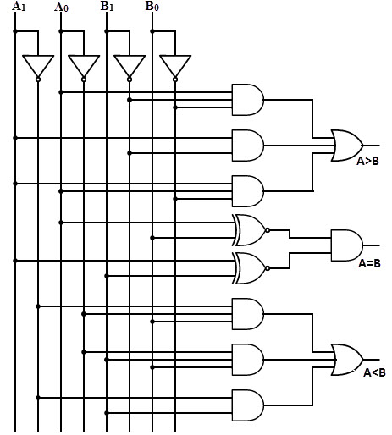
Classification of Comparators
1-bit Comparator
2-bit Comparator
Fig 3 1-bit Comparator
Fig 4: 2-bit Comparator

Slide 8
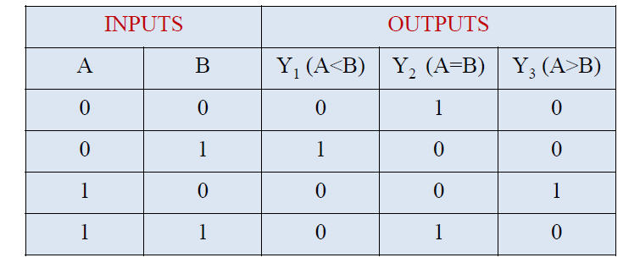
1-Bit Magnitude Comparator
•This magnitude comparator has two inputs A and B and three outputs A<B, A=B and A>B.
•This magnitude comparator compares the two numbers of single bits.
Fig 5 Truth Table of 1-Bit Comparator

Slide 9
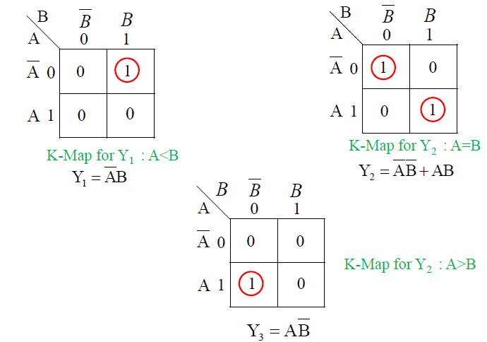
1-Bit Magnitude Comparator
Fig 6 K-Maps for all three outputs

Slide 10
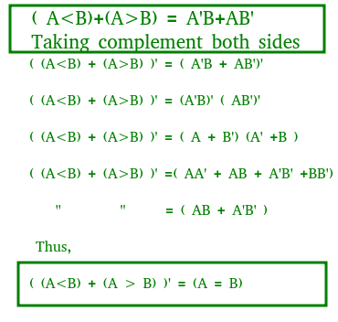
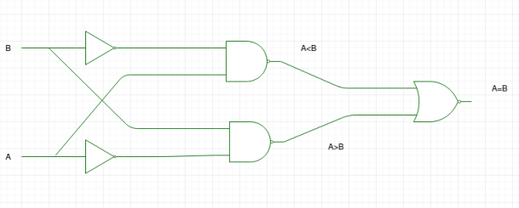
A>B: AB‘ A<B: A'B A=B: A'B' + AB
From the above expressions we can derive the following formula:

Slide 11
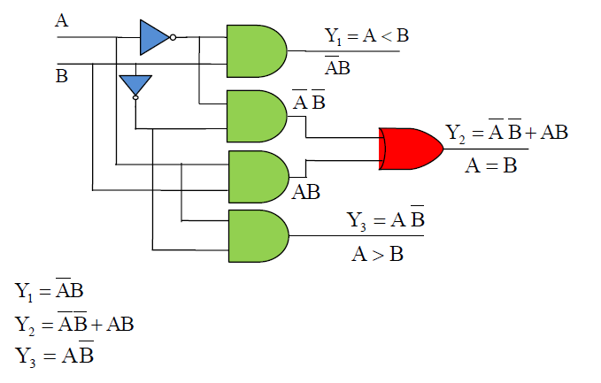
1-Bit Magnitude Comparator
Fig 7 Realization of 1-bit Comparator

Slide 12
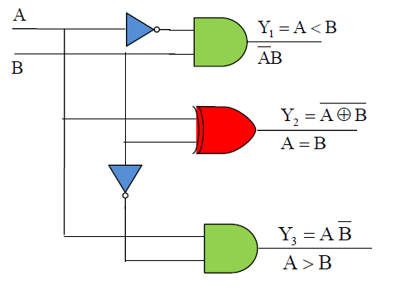
1-Bit Magnitude Comparator
Fig 8: Realization of by Using AND, EX-NOR gates

Slide 13
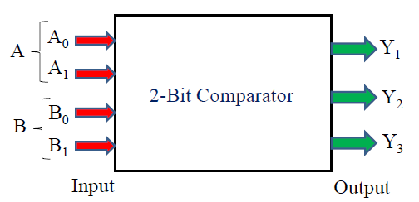
2-Bit Magnitude Comparator
A comparator which is used to compare two binary numbers each of two bits is called a 2-bit magnitude comparator.
It has four inputs and three outputs.
Inputs are A0,A1,B0 and B1 and Outputs are Y1,Y2 and Y3.
Fig 9: Block diagram of 2-bit Comparator

Slide 14
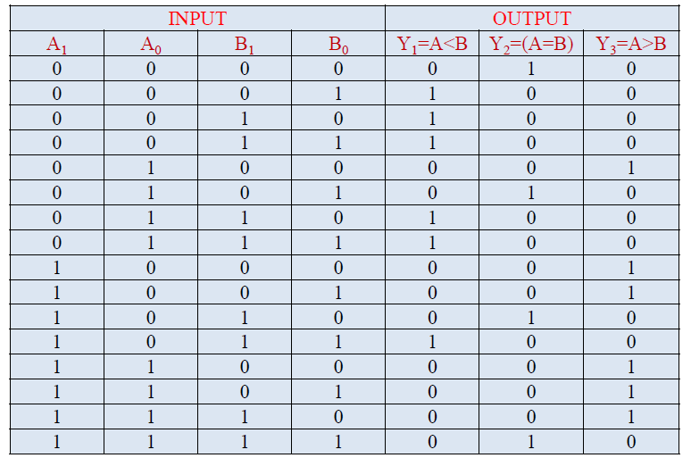
2-Bit Magnitude Comparator
Fig 10: Truth table of 2-bit Comparator

Slide 15
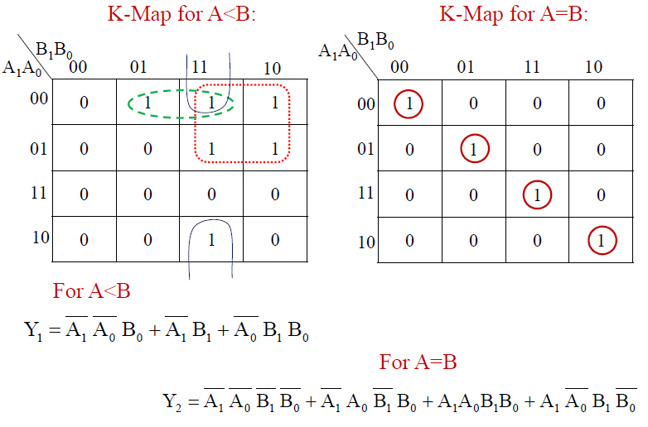
2-Bit Magnitude Comparator
Fig 11: K-Maps of 2-bit Comparator

Slide 16
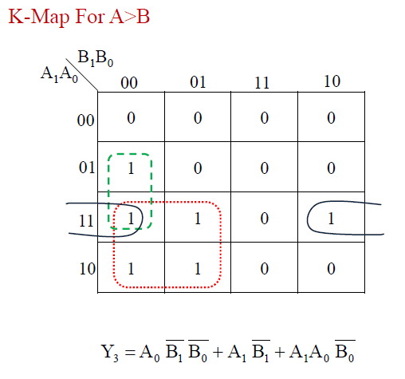
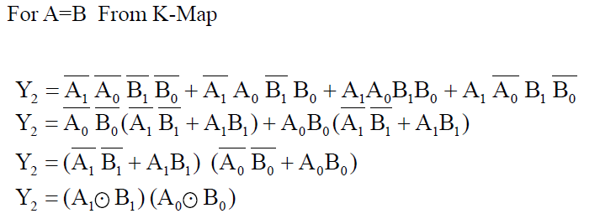
2-Bit Magnitude Comparator
Fig 12: K -Map of 2-bit Comparator

Slide 17
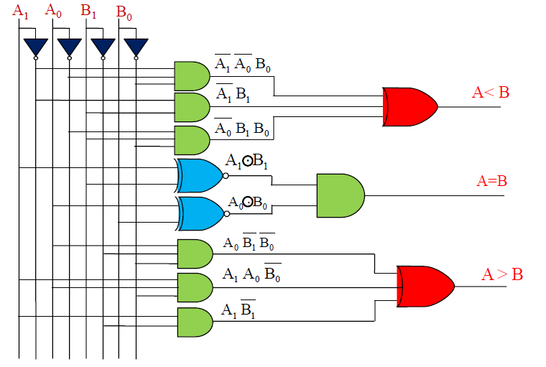
2-Bit Magnitude Comparator
Fig 13 Realization of 2-bit Comparator

Slide 18
Assessment Pattern
1. Design 1-Bit Magnitude Comparator ?
2. Design 2-Bit Magnitude Comparator ?

Slide 19
APPLICATIONS
1) These are used in the computers and microprocessor devices to select a specific input/output device for the storage.
2) These are used in control applications in which the binary numbers representing physical variables such as temperature, position, etc. are compared with a reference value.
3) Process controllers (ON/OFF, self-tune, and manual tune).
4) Servo-motor control ( Electrical plus).

Slide 20
REFERENCES
Mano,Morris, Digital Design, Prentice Hall of India.
Fletcher, An Engg. Approach to digital design, Prentice Hall of India.
https://www.electronics-tutorials.ws/combination/comb_8.html.
https://www.geeksforgeeks.org/magnitude-comparator-in-digital-logic/.
https://learnabout-electronics.org/Digital/dig43.php.
https://www.elprocus.com/digital-comparator-and-magnitude-comparator/.
https://www.electrical4u.com/digital-comparator/.

Slide 21
THANK YOU

